Slide 1
China and Global Talent Development: An Innovative Curriculum of Soft Landing
Ye-Sho Chen, Ph.D.
Director of Emerging Markets Initiative
Associate Director of International Franchise Forum
John W. Dupuy Endowed Professorship
Professor in Information Systems and Decision Sciences
E. J. Ourso College of Business
Louisiana State University
Email: qmchen@lsu.edu
Website: http://isds.bus.lsu.edu/chen
Acknowledgement: Funded Partially by the Business and International Education Program,
U.S. Department of Education

Slide 2
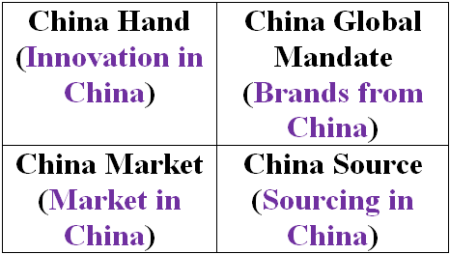
China and Global Talent Development
Ex: NBA & Yao Ming
(Sources: Zeng & Williamson, Dragons at your Door, 2007 & Perkowski, Managing the Dragon, 2008)
Broad
Extent of Cost Advantage
Narrow
Local
Global
Role of China

Slide 3
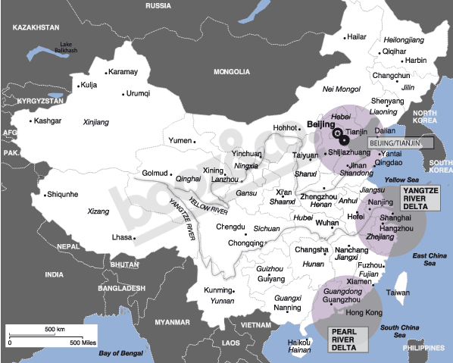
(Source: www.booz.com/global/home/what_we_think/the_china_strategy/47656646)

Slide 4
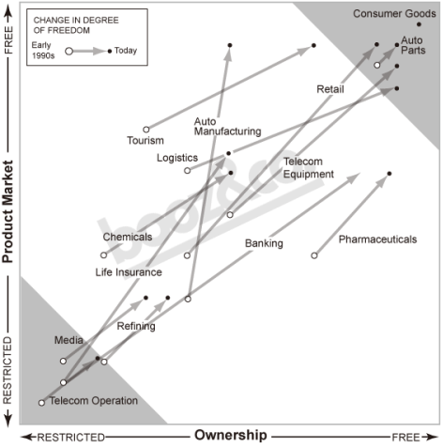
(Source: www.booz.com/global/home/what_we_think/the_china_strategy/47656688)

Slide 5
Old Microsoft: “Put Microsoft Products on Every PC”
100M
300M
900M
Start Here: $300 x 100M
Millions of pirated copies …
Law suits …
Angry consumers …
Turning to Linux …

Slide 6
New Microsoft: “Your Potential, Our Passion”
Bridging the Technology Gap by Cultivating the New Generation of Technology Entrepreneurs at the Bottom of the Pyramid.
100M
300M
900M
Grown up with Microsoft
Cultivating Loyal Consumers and Having Abundant of Opportunities to Make Moneys, e.g., $10 x 9M + $5 x 1M + … + $200 x 1M + …
(Source: Amazon.com)
(www.microsoft.com/unlimitedpotential)
Start Here: $4 x 900M
(Source: “How Microsoft Conquered China” (money.cnn.com/magazines/fortune/fortune_archive/2007/07/23/100134488))

Slide 7
Soft Landing Curriculum

Slide 8
The “Crashed” Man

Slide 9
Soft Landing
Soft landing is a process which helps a company from one country to land softly – without crashing, into the market of another country. (National Business Incubation Association)
Incubator as a Soft Landing Zone (Mencin & Erikson 2009)
Connecting key decision makers of demand and supply networks
Proven services of revenue generation

Slide 10
Leveraging the Global Networked Resources
Louisiana Business and Technology Center (www.bus.lsu.edu/lbtc) and its networks
Local
National
International
Our Partner in Brazil Universidade de São Paulo and its networks
Our Partner in China, Central University of Finance and Economics in Beijing, and its networks
Local
National
International
Local
National
International

Slide 11
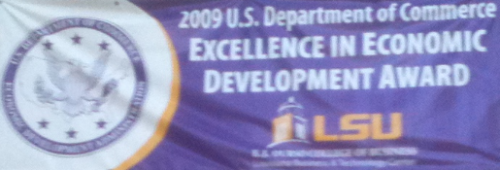
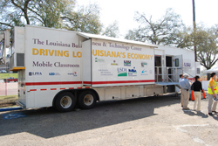
The Italian Man
(www.bus.lsu.edu/students/news/stories/2010.05.18_DAG.asp?dept=12)

Slide 12
Soft Landing Curriculum
It provides a platform for students and business communities to engage in global entrepreneurship via
Course content development
Social network development
Study abroad
Business plan development
New business incubation
Resource pooling and leveraging for business advancement
The goal is to help both parties to
Reduce risks and costs of their investments
Cultivate talented employees and partners
Create success storytellers

Slide 13
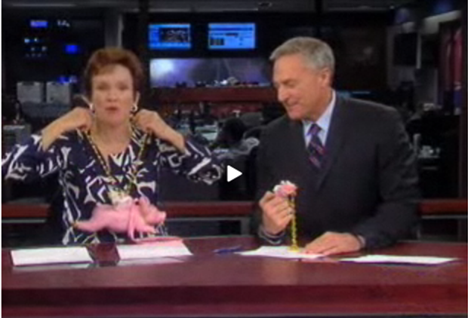
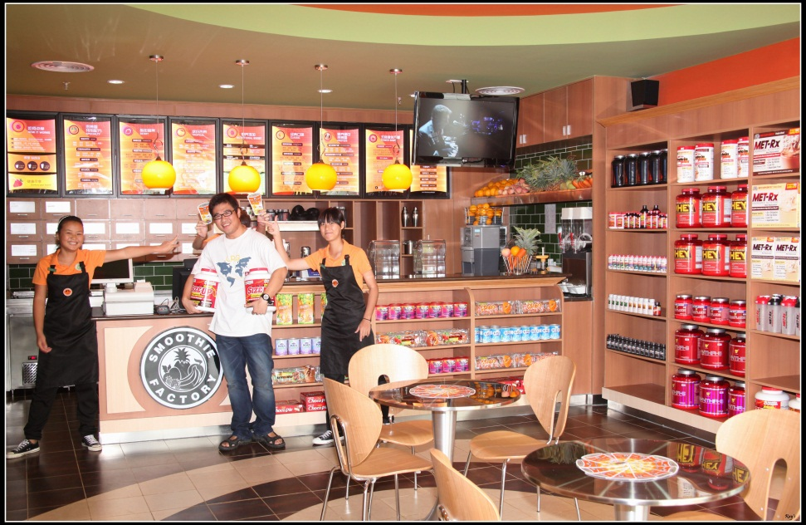
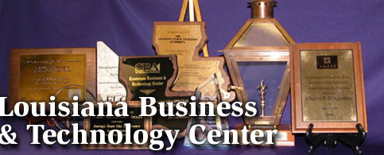
Examples of Soft Landing Curriculum: U.S. ➔ China & China ➔ U.S.
The Smoothie Man

Slide 14
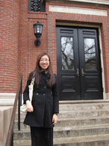
The Harvard Lady - Yunan Yuan
LSU STUDENT PRESENTS U.S.-CHINA RELATIONS RESEARCH AT HARVARD
(www.bus.lsu.edu/students/news/stories/2009.03.27_Yuan_Harvard.asp?dept=64)

Slide 15
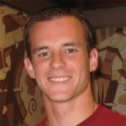
The MIT Man- John Casey
Took Entrepreneurship in China course in Spring 2008
President of Mandarin Association of Language and Life at LSU in 2008/2009
Critical Language Scholarship to China in the summer of 2009
Pursuing Bioengineering PhD at MIT in Fall 2009
Associate Director, MIT $100K (www.mit100k.org)

Slide 16
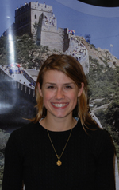
The China Lady - Maggie Hicks
LSU STUDENT TO INTERN FOR LOUISIANA-BASED COMPANY IN CHINA
(www.bus.lsu.edu/students/news/stories/2007.11.27_Hicks_China.asp?dept=64)

Slide 17
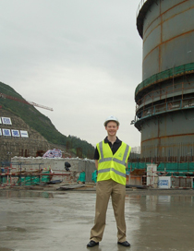
The Language Man - Ronald Courville
LSU FLORES MBA STUDENT EXPERIENCES INTERNSHIP OF A LIFETIME
(www.bus.lsu.edu/students/news/stories/2011.01.04_MBA_Intern_China.asp?dept=64)

Slide 18
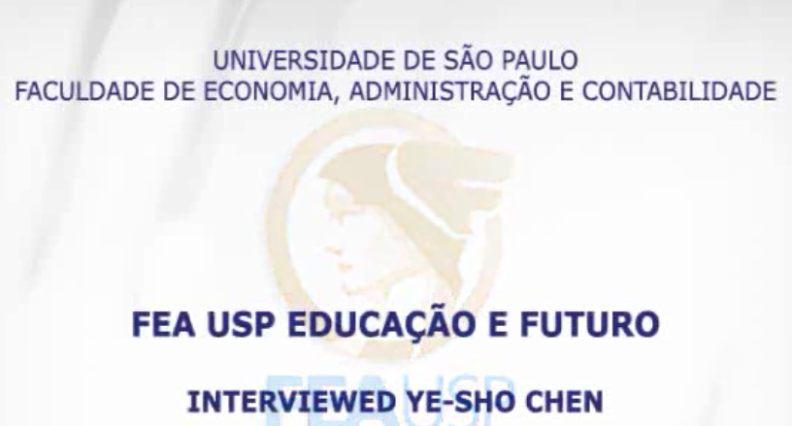
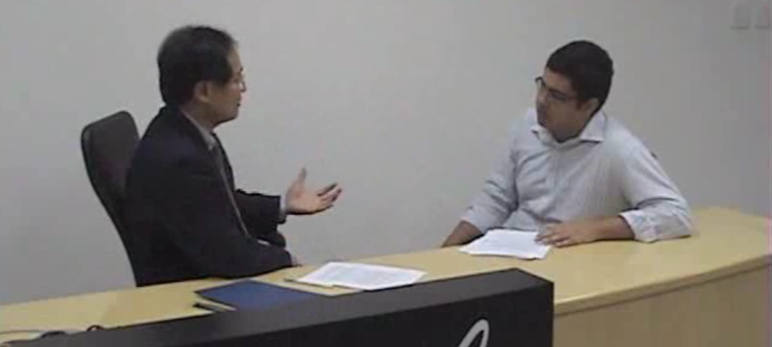
Lessons Learned: Characteristics of Success Storytellers – “PhD” Students
www.bus.lsu.edu/students/news/stories/2010.06.29_Chen.asp?dept=64

Slide 19
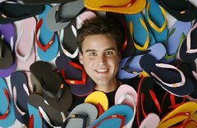
Lessons Learned: Resource Pooling & Leveraging – Elevator Speech Skills
The Flip-Flop Man (www.feelgoodz.com)
Green Manufacturer
in Thailand
+
Social Entrepreneurs
in New Orleans
+
Whole Food Store Networks
in U.S.
www.bus.lsu.edu/sei

Slide 20
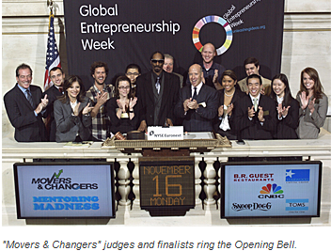
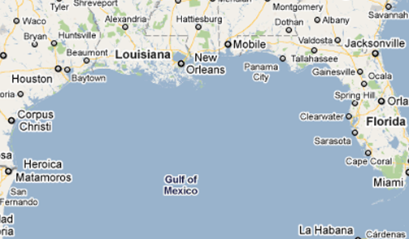
Lessons Learned: Sustainable Supply Chain – Green + Disaster
Hurricane Katrina in 2005 &
BP Gulf of Mexico Spill in 2010
exchanges.nyse.com/archives/2009/11/entrepreneur_leaders.php
Map.google.com
www.bus.lsu.edu/sdmi

